Slide 1
INTRODUCTION
19cse335 ETHICAL HACKING

Slide 2
Hacking
Gaining access to a system that you are not supposed to have access is considered as hacking.
A Hacker is a person who is intensely interested in the mysterious workings of any computer operating system.

Slide 3
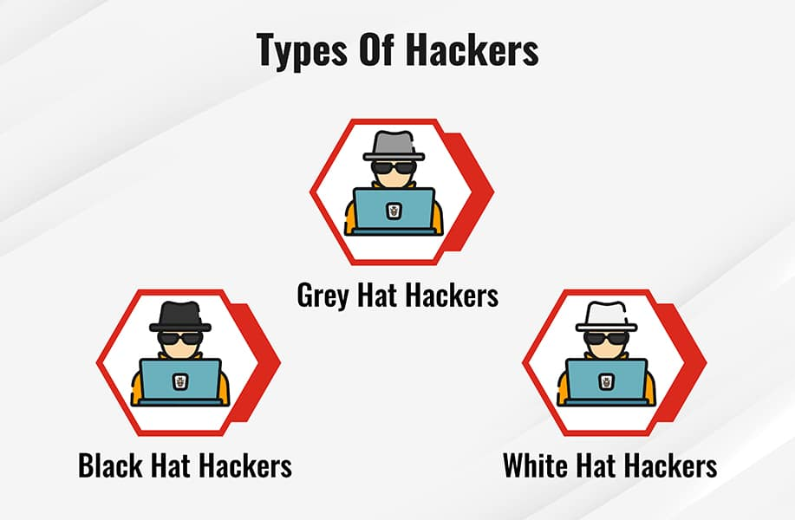
Types of Hackers
Hackers can be classified into three different categories:
Black Hat Hacker
White Hat Hacker
Grey Hat Hacker

Slide 4
Black Hat Hacker
Black-hat Hackers are also known as an Unethical Hacker or a Security Cracker.
These people hack the system illegally to steal money or to achieve their own illegal goals.
They find banks or other companies with weak security and steal money or credit card information.
They can also modify or destroy the data as well.
Black hat hacking is illegal.

Slide 5
White Hat Hacker
White hat Hackers are also known as Ethical Hackers or a Penetration Tester. White hat hackers are the good guys of the hacker world.
These people use the same technique used by the black hat hackers. They also hack the system, but they can only hack the system that they have permission to hack in order to test the security of the system.
They focus on security and protecting IT system.
White hat hacking is legal.

Slide 6
Grey Hat Hacker
Gray hat Hackers are Hybrid between Black hat Hackers and White hat hackers.
They can hack any system even if they don't have permission to test the security of the system but they will never steal money or damage the system.
In most cases, they tell the administrator of that system. But they are also illegal because they test the security of the system that they do not have permission to test.
Grey hat hacking is sometimes acted legally and sometimes not.

Slide 7
Ethical Hacking
Ethical hacking is also known as White hat Hacking or Penetration Testing.
Penetration testing can be defined as a legal and authorized attempt to locate and successfully exploit computer systems for the purpose of making those systems more secure.
The process includes probing for vulnerabilities as well as providing proof of concept attacks to demonstrate the vulnerabilities are real.
Proper penetration testing always ends with specific recommendations for addressing and fixing the issues that were discovered during the test.

Slide 8
On the whole, this process is used to help secure computers and networks against future attacks.
The general idea is to find security issues by using the same tools and techniques as an attacker. These findings can then be mitigated before a real hacker exploits them.
Penetration testing is also known as
Pen testing
PT
Hacking
Ethical hacking
White hat hacking
Offensive security
Red teaming.

Slide 9
Key principles of ethical hacking
Obey the law: Hacking is only ethical if you have permission to perform a security assessment of the system you're hacking.
Know the scope of the project: Stay within the boundaries of the agreement you have with the company. Know exactly what you're supposed to test and only test those systems.
Report all vulnerabilities: Report any vulnerabilities you find and suggest ways to fix them.
Respect any sensitive data: A Penetration Tester will often test systems that hold sensitive data and will have to sign a non-disclosure agreement.

Slide 10
Skills Required to become an Ethical Hacker
An ethical hacker should have in-depth knowledge about all the systems, networks, program codes, security measures, etc. to perform hacking efficiently.
Knowledge of programming - It is required for security professionals working in the field of application security and Software Development Life Cycle (SDLC).
Scripting knowledge - This is required for professionals dealing with network-based attacks and host-based attacks
Networking skills - This skill is important because threats mostly originate from networks. You should know about all of the devices present in the network, how they are connected, and how to identify if they are compromised.

Slide 11
Understanding of databases - Attacks are mostly targeted at databases. Knowledge of database management systems such as SQL will help you to effectively inspect operations carried out in databases.
Knowledge of multiple platforms like Windows, Linux, Unix, etc.
The ability to work with different hacking tools available in the market.
Knowledge of search engines and servers.

Slide 12
Basic Terminologies used in EH
Attack - An attack is an ethical hacking terminology used to refer to any action performed on a system with the intention of obtaining unauthorized access to data or sensitive information.
Vulnerability - In cybersecurity, a vulnerability is a weakness that can be exploited by cybercriminals to gain unauthorized access to a computer system. After exploiting a vulnerability, a cyberattack can run malicious code, install malware and even steal sensitive data.
Threat - A cyber or cybersecurity threat is a malicious act that seeks to damage data, steal data, or disrupt digital life in general. Cyber threats include computer viruses, data breaches, Denial of Service (DoS) attacks, and other attack vectors.

Slide 13
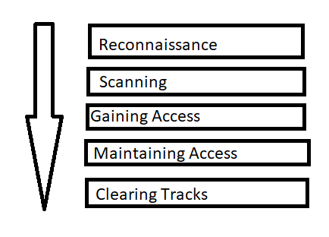
Phases of Ethical Hacking

Slide 14
1. Reconnaissance:
This is the first step of Hacking. It is also called as Footprinting and information gathering Phase.
This is the preparatory phase where we collect as much information as possible about the target. We usually collect information about three groups,
Network
Host
People involved

Slide 15
There are two types of Footprinting:
Active: Directly interacting with the target to gather information about the target. Eg Using Nmap tool to scan the target
Passive: Trying to collect the information about the target without directly accessing the target. This involves collecting information from social media, public websites etc.

Slide 16
2. Scanning
In this stage, the ethical hacker begins testing the networks and machines to identify potential attack surfaces.
This involves gathering information on all machines, users, and services within the network using automated scanning tools.
Three types of scanning are involved:

Slide 17
Port scanning: This phase involves scanning the target for the information like open ports, Live systems, various services running on the host.
Vulnerability Scanning: Checking the target for weaknesses or vulnerabilities which can be exploited. Usually done with help of automated tools
Network Mapping: Finding the topology of network, routers, firewalls servers if any, and host information and drawing a network diagram with the available information. This map may serve as a valuable piece of information throughout the hacking process.

Slide 18
3. Gaining Access:
This phase is where an attacker breaks into the system/network using various tools or methods. After entering into a system, he has to increase his privilege to administrator level so he can install an application he needs or modify data or hide data.

Slide 19
4. Maintaining Access:
Hacker may just hack the system to show it was vulnerable or he can be so mischievous that he wants to maintain or persist the connection in the background without the knowledge of the user.
This can be done using Trojans, Rootkits or other malicious files.
The aim is to maintain the access to the target until he finishes the tasks he planned to accomplish in that target.

Slide 20
5. Clearing Track:
No thief wants to get caught.
An intelligent hacker always clears all evidence so that in the later point of time, no one will find any traces leading to him.
This involves modifying/corrupting/deleting the values of Logs, modifying registry values and uninstalling all applications he used and deleting all folders he created.

